Slide 1
What happens
when you enter a URL in the browser?
Xing Chen
11/2023
Notes:
Hello and welcome everyone!
Today we're going to take an exciting journey into what happens when you enter a URL into your browser.
I'm Xing Chen, and I'm happy to guide you through the hidden world of web navigation.

Slide 2

Why needs to know?
Notes:
We browse the web every day, but the complex process behind this , seemingly simple operation remains a mystery to many people.
Before we dive in, let’s talk about why this is important.
At first, Let me show you 2 web pages.

Slide 3
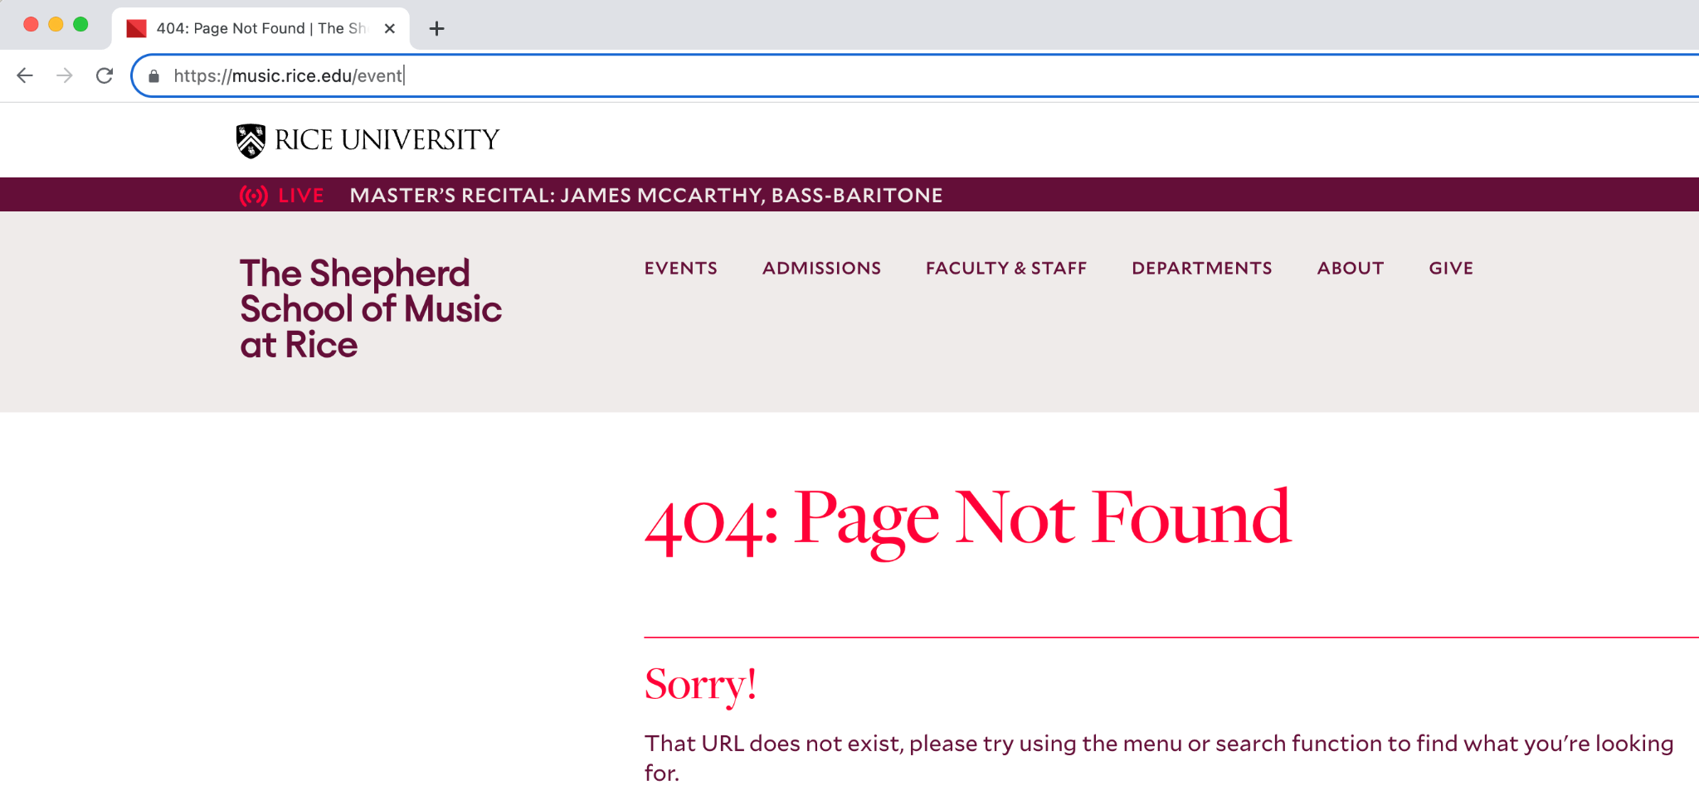
Why needs to know?
Notes:
You often encounter these two types of errors when surfing the Internet

Slide 4
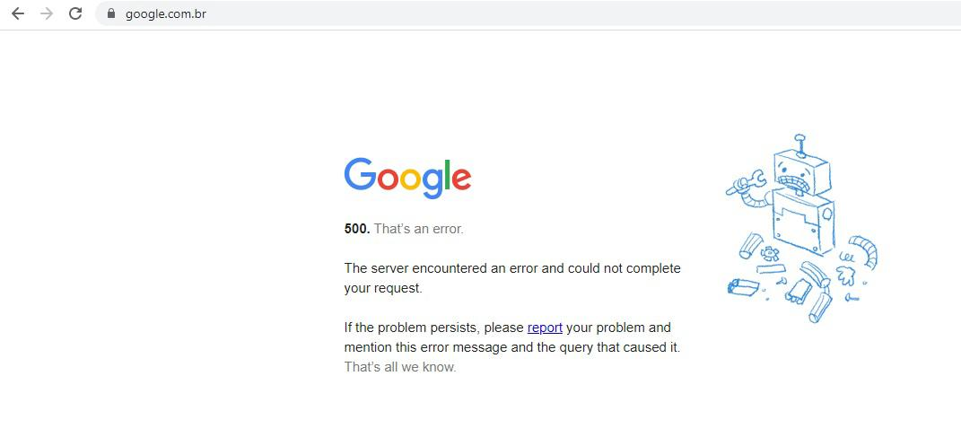
Why needs to know?
Notes:
So…
Do you want to know what happened? Why you get the page like these??
Let me explain this logic to you.

Slide 5
What is URL?
https://music.rice.edu/search/node?keys=violin
“Street Address”
https
music.rice.edu
keys=violin
Notes:
Let's start with the basics.
A URL(Uniform Resource Locator), is essentially the web address you enter the browser.
Think of it like a street address for the internet.
It has different parts: the protocol, the domain, and the path
guiding your browser to the exact location of the website you want to visit.

Slide 6
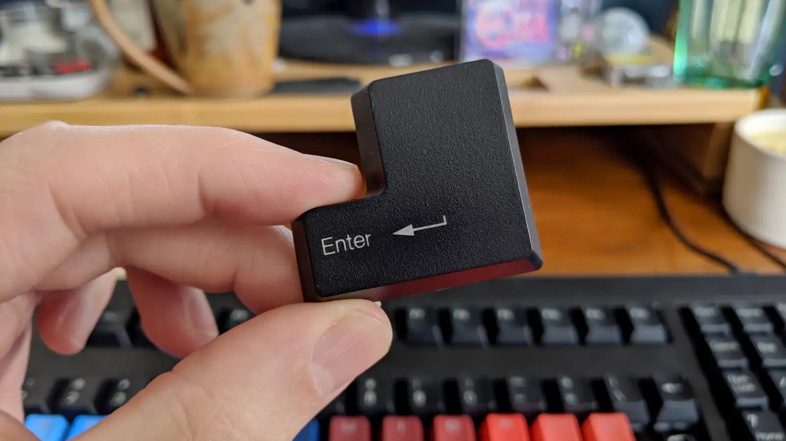
Journey Begins
Notes:
So, This is where the journey begins.
The moment you press enter, your browser starts a complex process, sending out a request to fetch the website you're looking for.

Slide 7
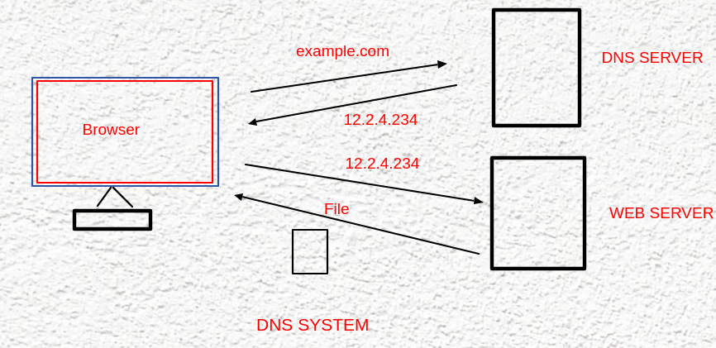
DNS lookup
Phone book
of
the Internet
Notes:
First stop: DNS lookup.
DNS (Domain Name System) is like the phone book of the Internet.
It converts the website name you enter (such as "music.rice.edu") into an IP address that your computer can understand.
This step is crucial for finding the actual location of a website on the vast internet.

Slide 8
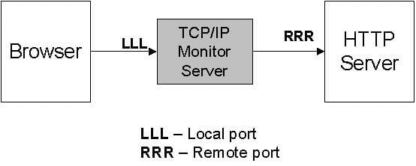
TCP/IP Connection With Server
Browser —--- TCP/IP —---Server
Notes:
Next, your computer uses TCP/IP protocols to establish a connection with the server who hosting the website.
Think of it like calling a phone number to start a conversation.
This connection is necessary for the two-way communication between your browser and the server.

Slide 9
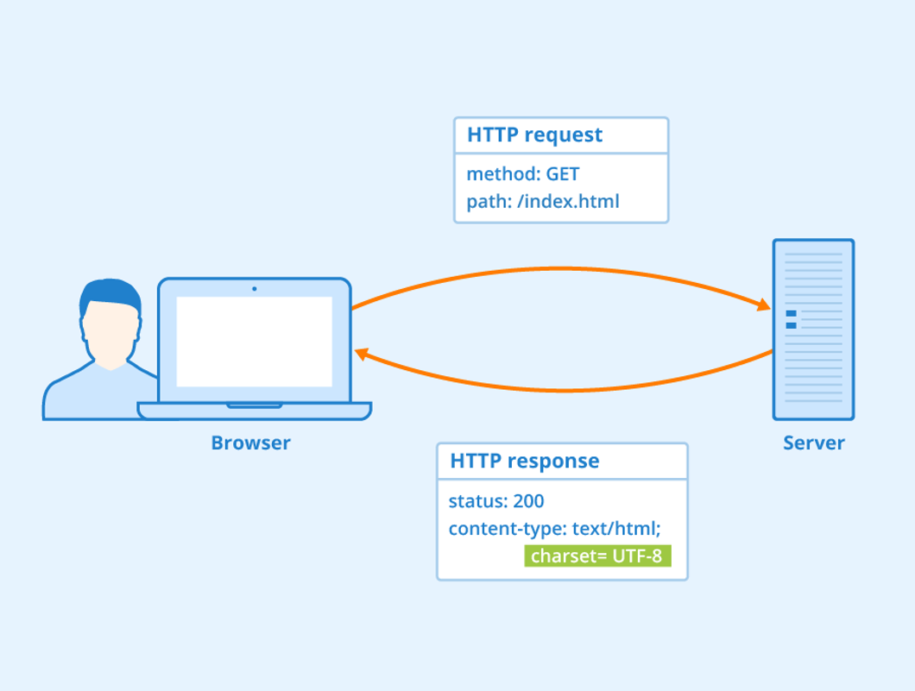
The browser sends HTTP request to Server
Notes:
After that, once the connection is secure
your browser sends an HTTP (or HTTPS for secure sites) request to the server
It's like sending a detailed letter asking for a specific web page

Slide 10
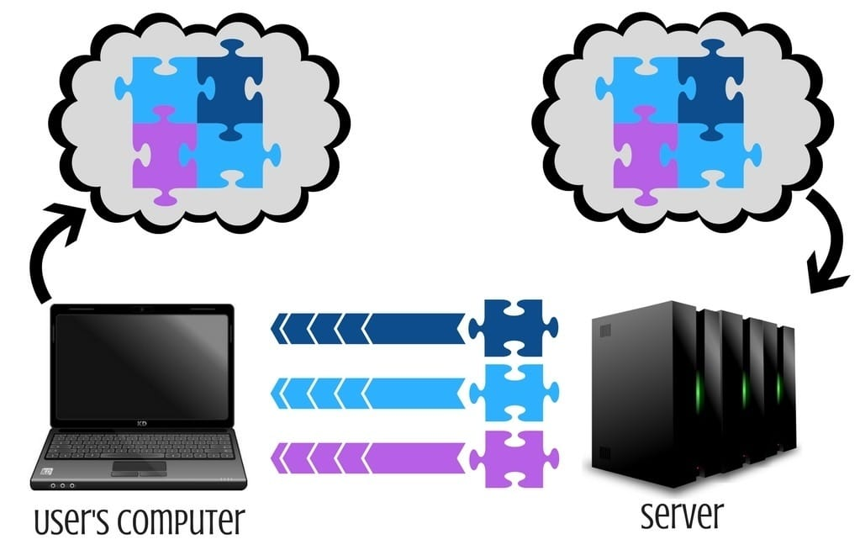
The server sends back data to browser
Notes:
The server then sends the data back to your browser in small packets.
These packets of data travel across the Internet,
carrying various parts of the web page you requested, like puzzle pieces finding their way to you.

Slide 11
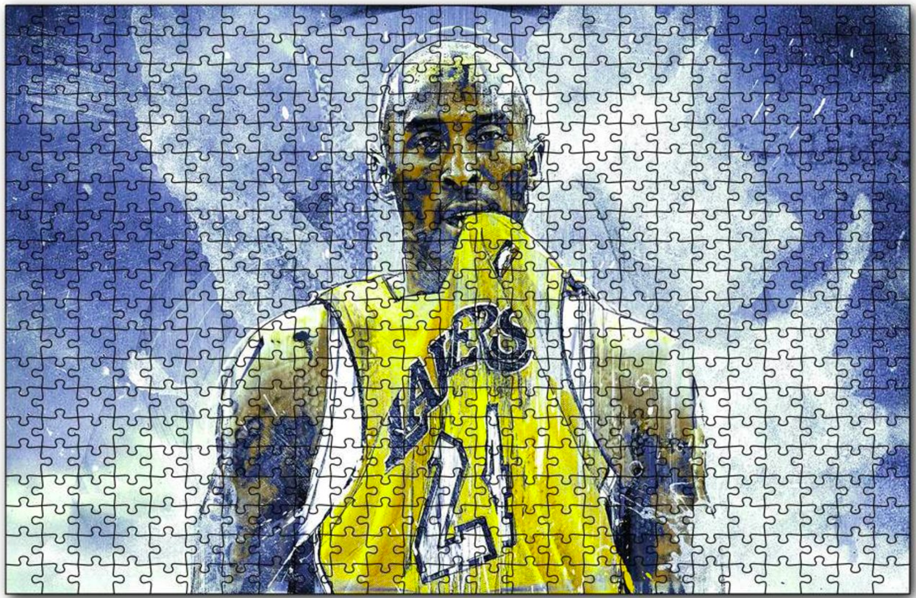
The browser rendering the page
Interpret
HTML, CSS, JavaScript
To
Webpage
Notes:
Once these data packets arrive, your browser starts rendering the page.
It interprets the HTML, CSS, and JavaScript, converting them into the webpage you see.
It's like assembling a puzzle to reveal a picture.

Slide 12
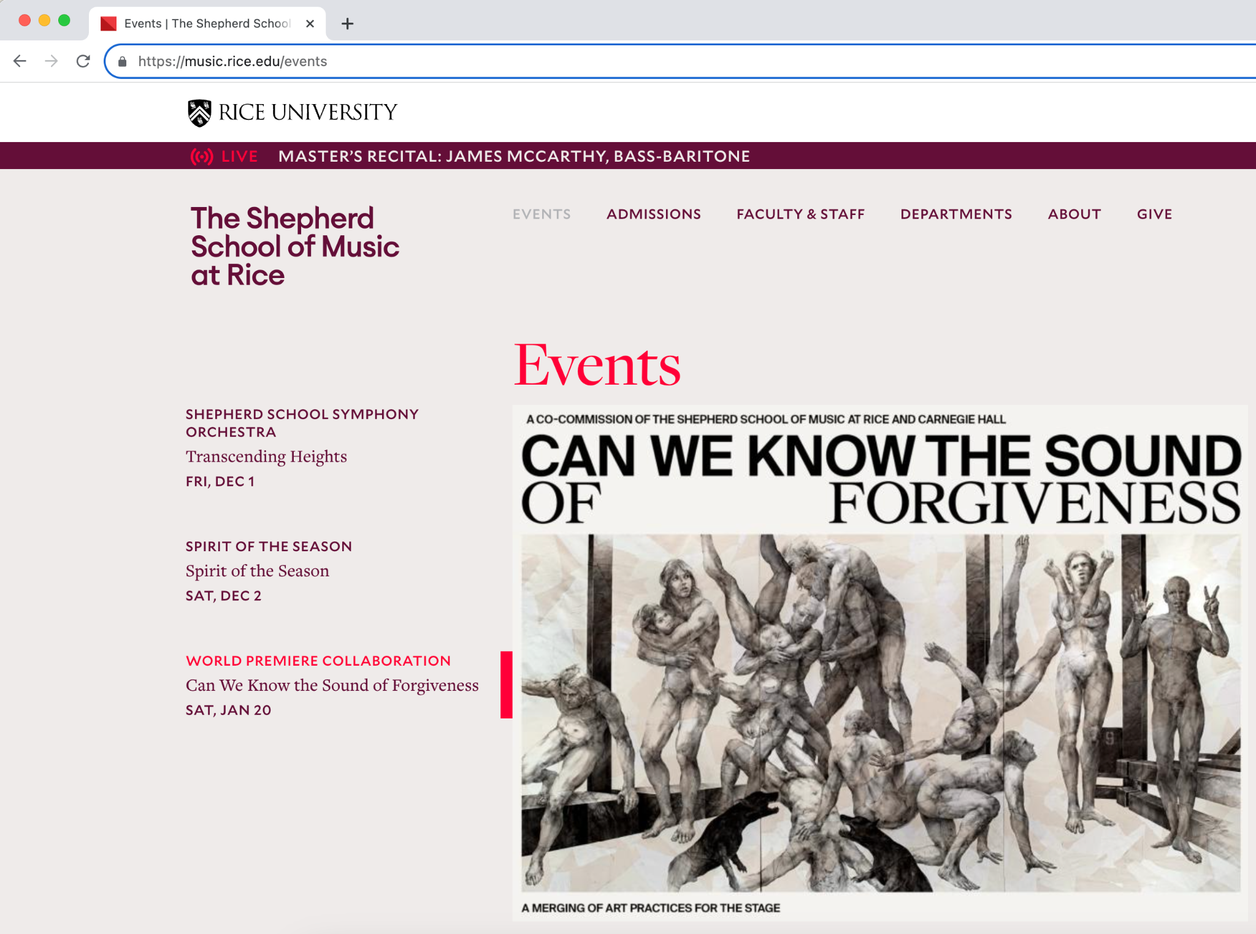
Why needs to know?
Notes:
Look! The page appears on your screen, fully loaded.
The entire process from entering a URL to displaying a web page usually only takes a few seconds.

Slide 13
Server feedback
200 OK
404 Page Not Found
Notes:
The server receives your request and processes it.
If it responds the page with a status code like '200', it means success.
Sometimes, you might get a '404 Not Found' or other error messages.
But if you get 500 error in a page? It tells you that a system error occurred.
You need to contact technical support or wait some time.

Slide 14
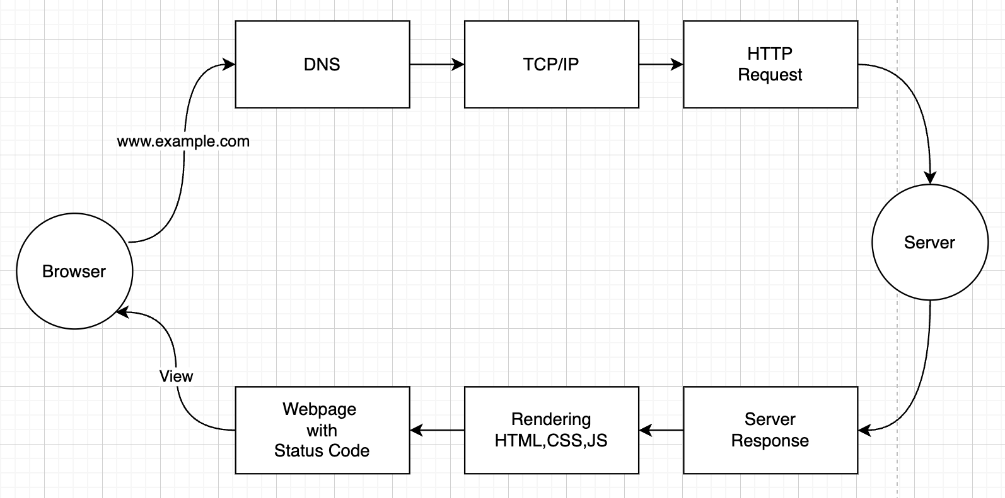
Notes:
Above all, we know about the whole processes of a URL from start to finish, they are DNS parse, TCP/IP Protocols, Send Http Request, server solve data, Server response data, Rendering in browser, Result webpage

Slide 15

In Conclusion
Understanding
Is
Crucial!
Please keep this slide for attribution
Notes:
In conclusion, understanding the journey of a URL from start to finish is more than just a curiosity.
It gives us a deeper appreciation of the internet's complexity,
and equips us with knowledge to navigate the internet more effectively.
This is crucial for web developers and anyone interested in the inner workings of the Internet.

Slide 16
Continue learning.
😊
Notes:
I encourage you to continue learning about this interesting topic.
Thank you for attention and happy surfing the Internet!

